Slide 1
BCA 2022-2025 Batch
Project Topic : Travelling Website
College Name : Dinabandhu Andrews Institute of Technology & Management
Paper Name: Industrial Training & Minor Project
Paper Code: BCAD581
Group Number: 8
Mentoring Faculty: Aditi Banerjee

Slide 2
Table of Contents
Slide 3 -> Introduction
Slide 4 -> Roles and responsibilities
Slide 5-6 -> Project features
Slide 7-> Architecture
Slide 8-14 -> User Interface
Slide 15 -> Conclusion
Slide 16 -> Acknowledgement
Slide 17 -> Bibliography

Slide 3
Introduction
In today's interconnected world, traveling has become more accessible and desirable than ever before. Whether it's exploring new destinations, planning a family vacation, or seeking solo adventures, a user-friendly platform can make the entire travel experience seamless and enjoyable. The name of our website is ‘SAFAR’, which in Hindi translates to ‘journey’. ‘SAFAR’ aims to serve as a one-stop solution for all travel-related needs. The website will offer an intuitive interface that allows users to explore destinations, compare travel packages, book accommodations, and discover exciting itineraries. With the integration of modern technologies such as real-time updates, interactive maps, and secure payment gateways, our platform ensures convenience and reliability for every traveler. This project not only emphasizes functionality but also focuses on creating an engaging user experience. By offering personalized recommendations, user reviews, and travel tips, the website fosters a sense of community among travelers while catering to their diverse preferences and needs. Through this travel website, we aim to transform the way people plan their journeys, making travel more exciting, efficient, and stress-free.

Slide 4
Roles and Responsibilities
Team member responsibilities
Name | Responsibility
Susmita Baidya | DEVELOPER,TESTER,COORDINATOR
Anisha Chakraborty | DEVELOPER,DATA COLLECTOR
Hrishita Ghosh | DEVELOPER, DATA COLLECTOR
Peulina Bose | DEVELOPER, DATA COLLECTOR
Sayak Chatterjee | DEVELOPER, DATA COLLECTOR
Nilabja Goswami | DEVELOPER,DOCUMENTATION

Slide 5
Project Features
Following are the Features of SAFAR
1.*User-Friendly Interface*
- Intuitive design for seamless navigation.
- Responsive layout optimized for mobile, tablet, and desktop users.
2. *Destination Search and Exploration*
- Comprehensive database of global destinations.
- Detailed information about attractions, culture, and local experiences.
3. *Travel Packages*
- Curated tour packages for solo, family, or group travelers.
- Option to customize itineraries based on user preferences.
4. *Accommodation Booking*
- Wide range of accommodations (hotels, hostels, resorts, etc.).
- Filters for budget, amenities, and location.

Slide 6
.
6. *Interactive Maps*
- Visual representation of destinations and routes.
- Integration with Google Maps for navigation assistance.
7. *User Reviews and Ratings*
- Trusted reviews and ratings from other travelers.
- Option to add personal reviews to help the community.
9. *Secure Payment Gateway*
- Multiple payment options with encryption for security.
- Support for international currencies.
10. *Customer Support*
- 24/7 live chat and helpline for resolving queries.
- Email and chatbot support for assistance.

Slide 7
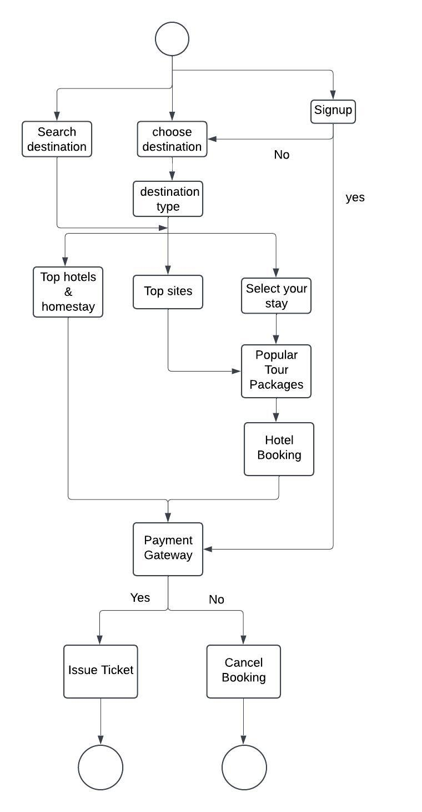
Architecture
FLOW DIAGRAM

Slide 8
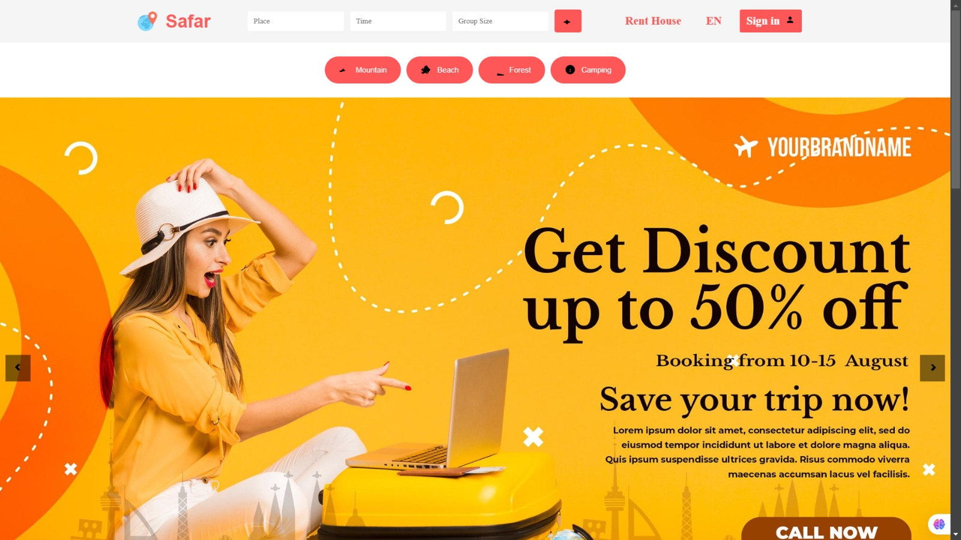
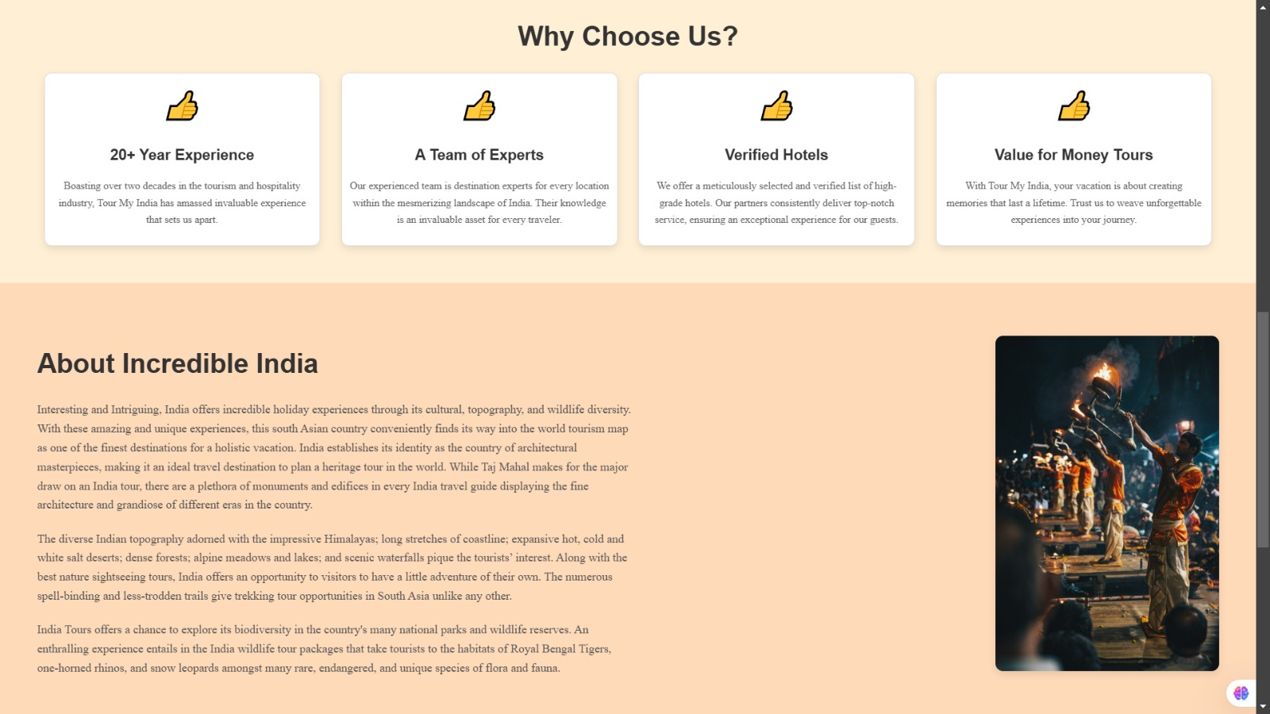
User Interface
HOMEPAGE
Welcome to SAFAR, your ultimate travel companion! Whether you're dreaming of sandy beaches, exploring vibrant cities, or embarking on outdoor adventures, we’ve got you covered. Discover curated travel guides, expert tips, and the best destinations for your next getaway.
.

Slide 9
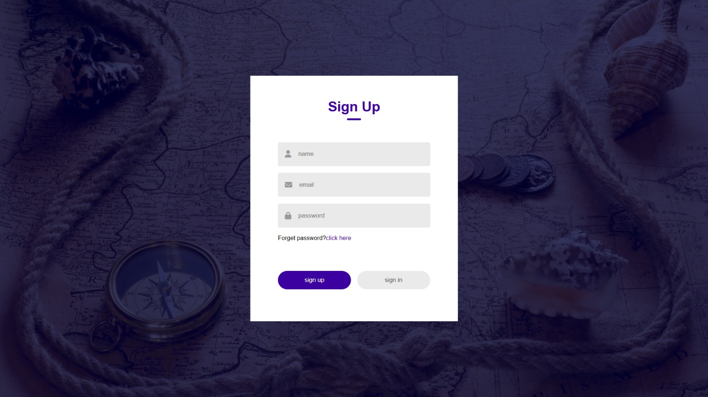
User Interface
SIGNUP/SIGNIN PAGE
Here users can sign into their SAFAR account and also create account using signup.
.

Slide 10
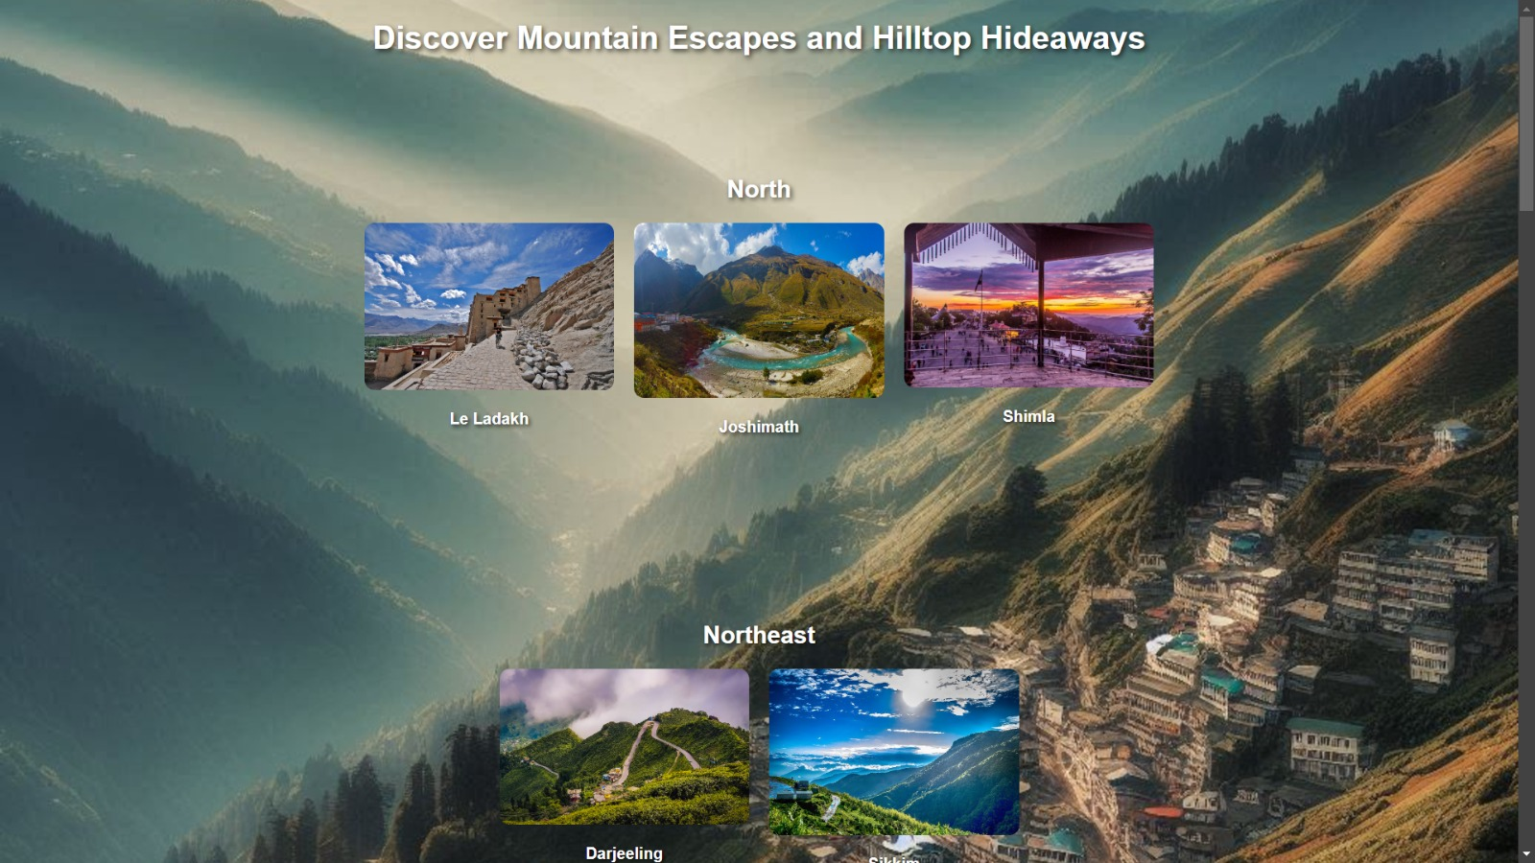
User Interface
CATEGORY SECTION:
Here you can select your destinations based on your search.
.

Slide 11
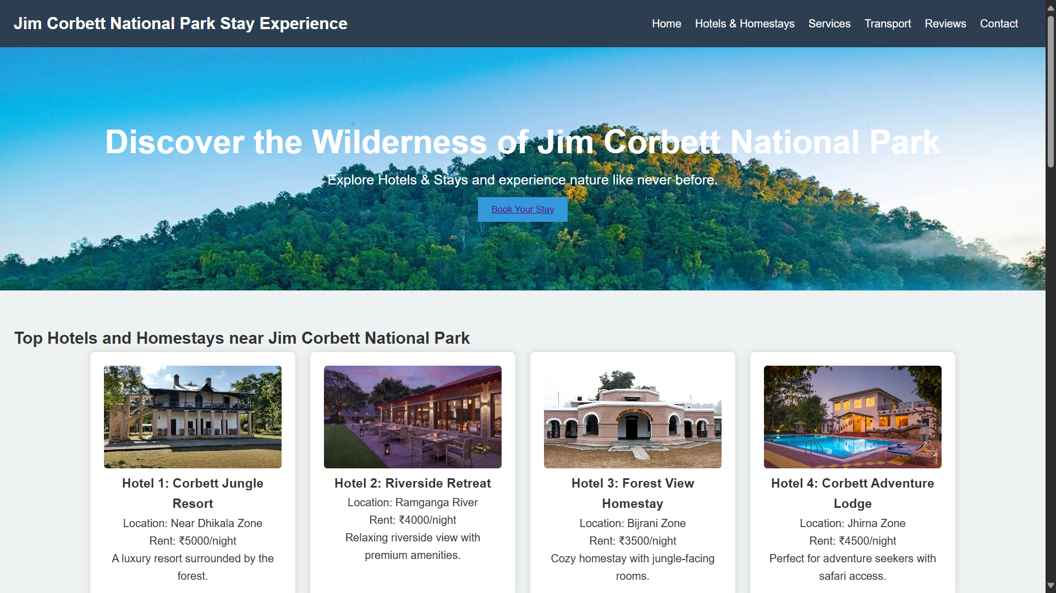
User Interface
TOP HOTELS & SITES
Here you can get best top deals of the hotel & homestay packages.
.

Slide 12
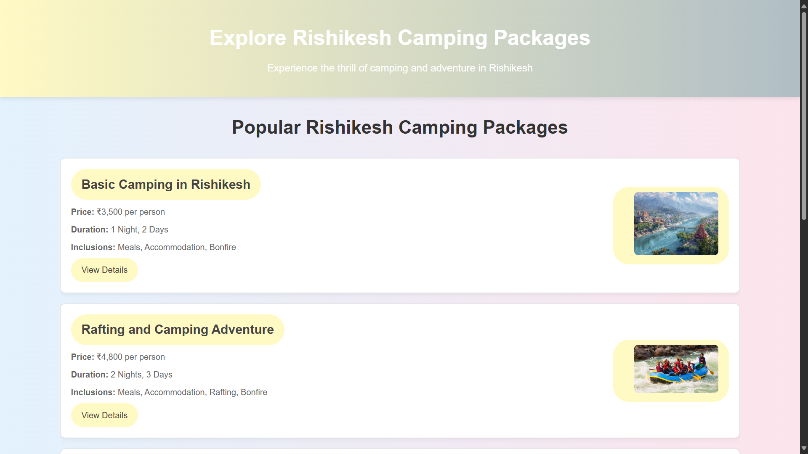
User Interface
TOUR PACKAGES
Here you’ll get all available packages & offers of your selected destination.
.

Slide 13
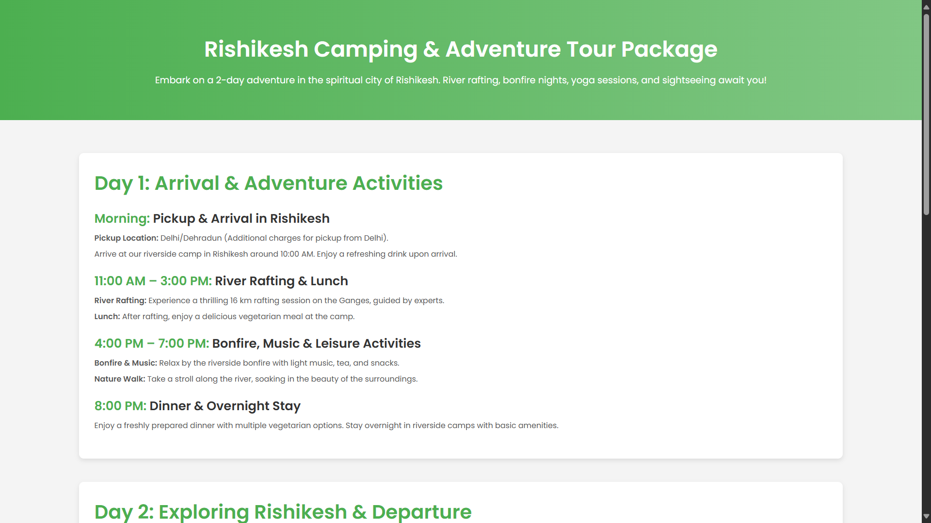
User Interface
TOUR GUIDE
Here, you can get an idea of your tour plans.
.

Slide 14
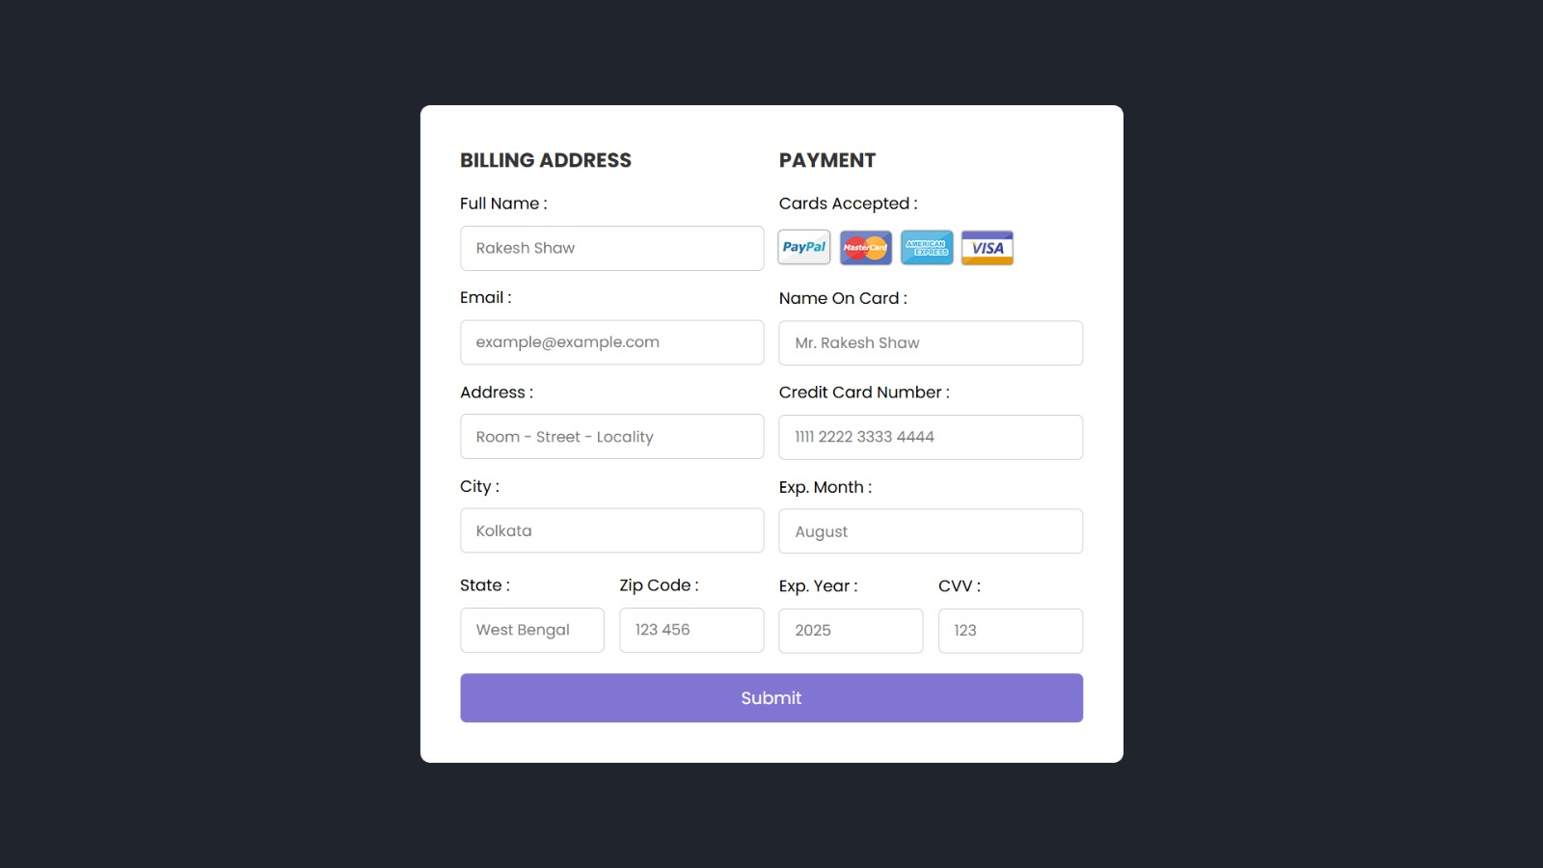
User Interface
PAYMENT GATEWAY
Here, you can complete your transaction, based on your purchases.
.

Slide 15
Conclusion and Future Work
The aim of SAFAR, is for creating a user-friendly, safe tour website for potential Customers and Clients .At SAFAR, we believe that every journey is an opportunity to discover, explore, and connect with the world around us. Whether you're a seasoned traveler or just beginning to explore new horizons, we're here to guide you every step of the way. From handpicked destinations to personalized itineraries, we aim to make your travel experiences unforgettable.
Let SAFAR be your trusted partner in exploration—start your adventure today and make every journey a story worth telling.
Your world is waiting. Let's explore it together with SAFAR.

Slide 16
Acknowledgement
We hereby, thank our Project mentor, Aditi Banerjee for guiding us throughout
the duration of this project and also all our team members for their collective
assistance in completion of this project. We want to thank our college for giving us this
opportunity for doing this Minor project.

Slide 17
Bibliography
Chat-GPT
Microsoft edge
Copilot
Geeks for geeks
Chrome
Wikipedia

Slide 18
Thank You☺

